Slide 1
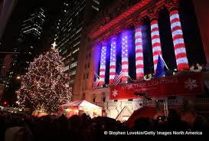
MERRY CHRISTMAS
The News Laid Out Week by Week!
December 2015
Message from the CEO / CFO
CEO Gabriel E. Miller
Merry Christmas, and Happy Holidays, Thank you for all your hard work. It has truly been a amazing experience working with you all. We did not win the business plan competition, but we all should be proud of what we accomplished. I wish to see you all in the new year.
CFO Alejandro Fernandez
I must admit we have been improving as a business but the progression has been slow. There are still certain things we must focus on to enhance our working habits. Above all we have been doing exceptionally well and it is in our best interest to keep it that way. The time of year has come for a long relaxing Christmas break; each and every one of us including Ms. Mitchell deserves to take this time to reflect and enjoy life. Being grateful of what we have and respecting what we don’t have. At the end of the day we all live with our choices and sacrifices we have to make. So let’s enjoy Christmas and have a Happy New Years.
QUOTE
“Within the covers of the Bible are the answers for all the problems man faces.”
- President Ronald Reagan

Slide 2
MERRY CHRISTMAS
The News Laid Out Week by Week!
December 2015
Department of the month
Congratulations Administration
you are the Department of the Month!
Current Events
December 7- Pearl Harbor 74th Anniversary (Monday)
December 22 – Business Plan competition (Tuesday)
December 24 - Christmas Eve (Thursday)
December 25 – Christmas Day (Friday)
December 31 – News Years Eve (Thursday)
December 13 - National Guard Since 1636
Employee of the month
Congratulations Saite Chen you are the employee of the month! We have to recognize the man who pays us, at least once a year.
New product Arrivals
Categories
Tops
Dresses
Suits
Bottoms
Shoes
Accessories
HAPPY birthday!
December
Gabriel E. Miller: December 4
Rafael Lagos: December 7
Purnata Anwar: December 31

Slide 3
MERRY CHRISTMAS
The News Laid Out Week by Week!
December 2015
Funny Christmas Jokes
Q: What do you call an elf who sings?
A: A wrapper!
Q: Why is Christmas just like your job?
A: You do all the work and the fat guy with the suit gets all the credit.
Q: What's the difference between the Christmas alphabet and the ordinary alphabet?
A: The Christmas alphabet has Noel.
Q: What do you call people who are afraid of Santa Claus?
A: Claustrophobic.
Q: Why was Santa's little helper depressed?
A: Because he had low elf esteem.
Q: What nationality is Santa Claus?
A: North Polish.
Q: What do you call a kid who doesn't believe in Santa?
A: A rebel without a Claus.
The Santa Claus Cycle:
You believe in Santa Claus
You don't believe in Santa Claus
You dress up as Santa Claus
You look like Santa Claus

Slide 4
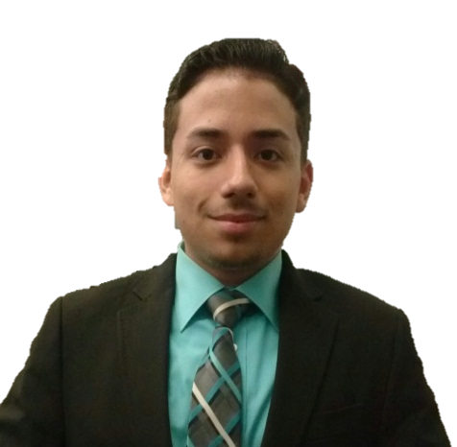
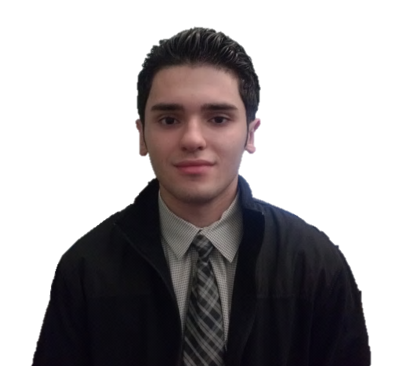
MERRY CHRISTMAS
The News Laid Out Week by Week!
December 2015
CEO / CFO Employee Profiles
Gabriel E. Miller
CEO
Age: 17
Likes: Help to help others and research current events.
Dislikes: People who don’t live up to their potential and slack.
A little bit About you:
in the Future I would like to have my Non-Profit Business helping teenagers combat depression. Later on I would enter politics.
Alejandro Fernandez
CFO
Age: 17
Likes: Having fun, Sports, Talking, Dancing, Eating, Spending time with my girl friend.
Dislikes: Not using my time Wisely
A little bit About you:
I love learning new things and explaining things. Also I love seeing people happy and giving people things, whatever it is gifts, or support, or any form of me helping people.

