Slide 1
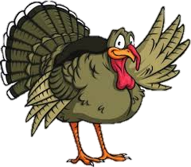
Fight For France!
The News Laid Out Week by Week!
November 2015
Message from the CEO / CFO
CEO Gabriel E. Miller
To my colleagues; We are in our second month and our business is prospering. We were able to secure a number of business to business contracts and we have over 1 million dollars of cash on hand. I want to thank you for your hard work and always remember, we are a team. Now, as we approach the Thanksgiving holiday and the leaves continue to fall from the trees, I wish you a Happy Thanksgiving that is full of love, warmth, and extra special moments.
CFO Alejandro Fernandez
To my fellow colleagues, we have been a thriving team with dedication and passion though out the 1st marking period. We have accomplished a great amount of quality work but we still have a long way to go. I know it may be difficult at times to complete your task in a timely manner due to unforeseen events, but These events are learning opportunities for us to grow and help us understand how we can work through these obstacles. Unfortunately now is not the time to celebrate because we are far from reaching our goals but the day will come when we will celebrate together.
QUOTE
“You all laugh because I am different. I laugh because you are all the same.”
- Unknown

Slide 2
Fight For France!
The News Laid Out Week by Week!
November 2015
Department of the month
Congratulations Web Design you are the Department of the Month! Hard work and patience goes along way. Our website would not be this amazing with out you.
New product Arrivals
Categories
Cardigans
Jackets
Sweaters
Ties/ Bow Ties
Wallets
Watches
Coats
Skirts
Jeans
Rompers
Employee of the month
Congratulations Marc Hallinger you are the employee of the month!
HAPPY birthday!
November
Marc Hallinger: November 7
Marcos Casado: November 11
Edgar Gomez: November 18
CURRENT Events
November 6 – Networking Event
November 12- CEO Networking Trip to Germany
November 14 – Networking Workshop

Slide 3
Fight For France!
The News Laid Out Week by Week!
November 2015
Thanksgiving Jokes
Josh: Why did the farmer run a steamroller over his potato field on Thanksgiving Day? Phil: Why? Josh: He wanted to raise mashed potatoes.
Biff: Why did the turkey cross the road? Bob: I don’t know. Biff: It was Thanksgiving Day, and he wanted people to think he was a chicken!
Charles: What is a turkey’s favorite dessert? Mary: I haven’t a clue. Charles: Peach gobbler!
Luke: What did the turkey say to the computer? Will: What? Luke: “Google, Google, Google.”
Josh: What do you get when you cross a turkey with a centipede? David: Tell me. Josh: Drumsticks for everyone on Thanksgiving Day!
Pedro: What did the turkey say to the turkey hunter on Thanksgiving Day? Nick: What? Pedro: “Quack! Quack!”

Slide 4
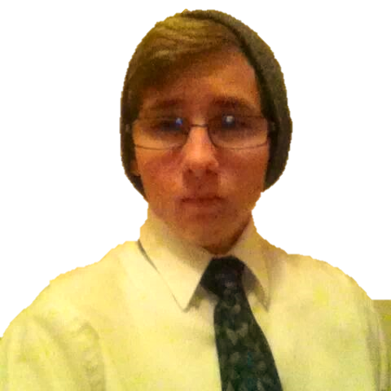
Fight For France!
The News Laid Out Week by Week!
November 2015
Human Resources Employee Profiles
Cosme Tellez
Vice President
Age: 16
Likes: Science and History
Dislikes: Slackers and Math
A little bit About you:
I’m aspire to become a surgeon in the future because I like helping people in need. I know it’s a long road to there but I know I’ll get there and succeed.
Marc Hallinger
Assistant Vice President
Age: 17
Likes: U.S. of A.
Dislikes: Anti-Americans
A little bit About you:
I love the United States of America with all my heart. I want to join the U.S. Navy or U.S. Marine Corps as a Explosive Ordnance Disposal or a Mechanic.
Mahdi Chowdhury
Payroll Coordinator
Age: 19
Likes: Food and Songs
Dislikes: Bullies
A little bit About you:
I work in my father’s restaurant on the weekends and make money. In my future I want to be a businessman. I want to buy a big house and a car. I want to get married and have kids as soon as possible. Also I want to take over my father’s restaurant.

